Slide 1

Developing XML Web Services and Server Components with Visual C# .NET
PART III
COMPONENT SERVICES
Amir Ahani
Microsoft Certified Solution Developer (MCSD .NET)
Microsoft Certified Application Developer (MCAD)
Microsoft Embedded Partner (www.mswep.com)

Slide 2

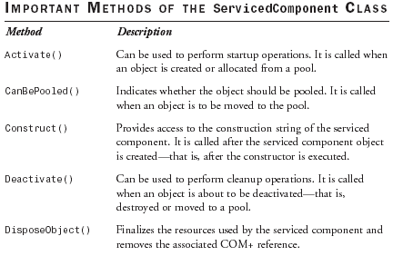
Architecture of Component Services
Serviced Components
One of the most important classes in the System.EnterpriseServices
namespace is the ServicedComponent class. Any class that uses
enterprise services must derive from the
System.EnterpriseServices.ServicedComponent class. Such a class is
also called a serviced component. Classes that derive from
ServicedComponent must be public and concrete, and must provide a
public default constructor.

Slide 3
Declarative Programming Model
Unlike the conventional procedural model, the programming model for
enterprise services is mostly declarative. In the procedural model, you
write code to accomplish a task, whereas in the declarative model you
use declarative tags that instruct the underlying platform to accomplish a
task. With a serviced component, the declarative tags specify the
services that the component receives, such as transactions, just-in-time
activation, object pooling, and so on.
In Visual C# .NET, the declarative tags are specified by attributes. You
can place attributes on certain program elements such as an assembly,
a class, and methods to specify runtime information. At runtime, the
attribute values can be manipulated through a mechanism called
reflection. After the application is deployed, administrators can use tools
such as the Component Services administrative tool to manipulate the
attribute values and change the application’s behavior without any need
to recompile the application.

Slide 4
COM+ Applications
A COM+ application is a group of serviced components that perform
related functions. Each of these components further consists of
interfaces and methods. A COM+ application is the primary unit of
administration and deployment for the serviced components.
A COM+ application is always stored in a DLL file. A DLL file cannot
run on its own, so a COM+ application is always configured to
run in one of the following two ways:
  Server Application—In a server application, a COM+ application
  runs in its own process. To enable this, COM+ provides
  a surrogate process (dllhost.exe) that hosts the DLL file for
  the COM+ application.
  Library Application—In a library application, the COM+
  application runs in the process of the client that creates it. To
  enable this, the components in a library application are always
  loaded into the process of the creator.

Slide 5
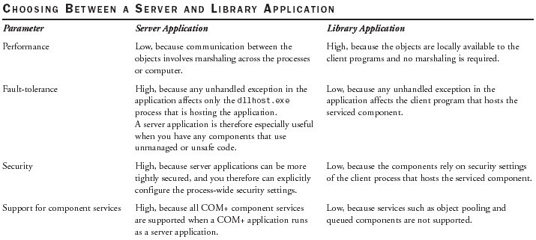

Slide 6
COM+ Catalog
The COM+ Catalog stores the information about the COM+ applications.
Each COM+ application and serviced component is uniquely identified in
the COM+ Catalog by a globally unique identifier (GUID). The other
important information stored in the COM+ Catalog for a serviced
component is its runtime requirements. For example, if a component
requires a transaction, this information is stored in the COM+ Catalog.
Later, when the component is activated, COM+ services use the catalog
to determine the runtime requirements of components.
The COM+ Catalog itself is physically split between the following
locations:
  COM+ Registration Database (RegDB), which is stored in the
  Registration directory of the Windows installation (such as
  c:\windows\registration).
  Windows Registry within a key named HKEY_CLASSES_ROOT.

Slide 7
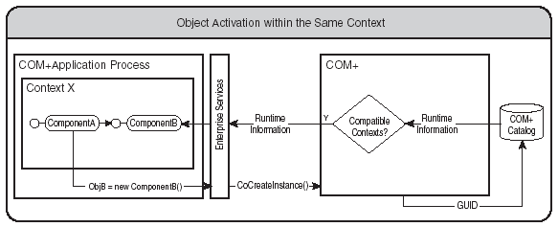
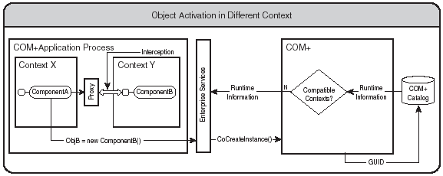
Serviced Component Activation

Slide 8
Context
A context is a set of runtime properties that defines the execution
environment for a serviced component. A context is created during
the activation process for a serviced component based on how the
serviced component is configured.
Objects having the same runtime requirements share a context, whereas
those having incompatible runtime requirements must reside in different
contexts.

Slide 9
Interception
Interception is a mechanism that allows COM+ to capture calls to
any object and execute its own code before passing the call to the
object.
When two objects are in the same context, no interception is required
because the objects have the same runtime requirements.
However, when the objects reside in different contexts, it is important
to ensure that appropriate runtime requirements for individual contexts
are satisfied. Therefore, the objects in a different context use a proxy to
communicate rather than make direct calls to each other. The proxy uses
interception to ensure that the runtime requirements are met.
Interception is available at two levels:
  Object level—This level of interception allows the proxy to perform pre-
  processing and post-processing operations when an object is created and
  destroyed. This level of interception is helpful in providing object-level
  services such as object construction and object pooling.
  Method level—This level of interception allows the proxy to perform pre-
  processing and post-processing operations when a method is invoked on an
  object. This level of interception is useful in providing method-level services
  such as just-in-time activation and transactions.

Slide 10
Creating and Consuming a Serviced Component
Creating a Serviced Component
Creating a Strongly Named Assembly
Registering the Serviced Component into the COM+ Catalog

Slide 11
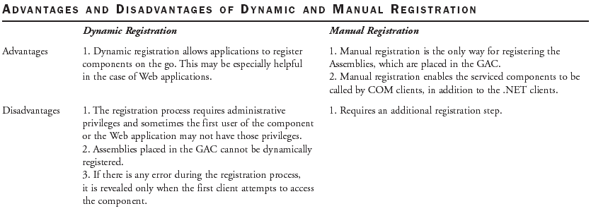
Registering the Serviced Component
Dynamic or Lazy Registration—In dynamic registration, the registration
of a serviced component is delayed until the component is first used.
When a client application attempts to create an instance of a serviced
component for the first time, the CLR registers the assembly and the
type library and configures the COM+ Catalog. Dynamic registration
occurs only once for a particular version of an assembly.
Manual Registration—The .NET Framework provides the .NET
Services Installation tool (regsvcs.exe) to manually install a serviced
component from the command line.

Slide 12
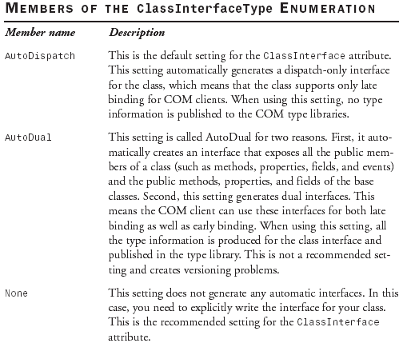
Creating Interfaces that are visible to COM/COM+
  The ClassInterface Attribute
  The ClassInterface attribute specifies how the interfaces will be
  generated for a class (if they will be generated at all). This attribute
  can be applied either to a class or to an assembly. If you apply this
  attribute to an assembly, the attribute applies to all the classes in that
  assembly.

Slide 13
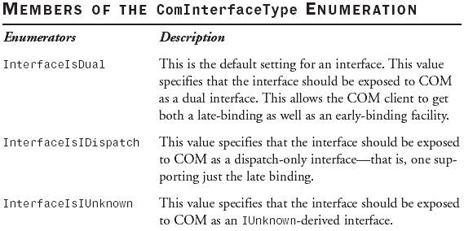

Creating Interfaces that are visible to COM/COM+
  The AutoDual setting of the ClassInterface exports the type
  information and DispId of the class and base class members to the
  COM type library. This enables COM clients to bind their programs
  with the DispId of the members at compile time. The DispIds are
  generated based on the position of the member in the class. This
  causes a versioning problem because if in the next version of your
  component you change the order of the members and export the
  class to a COM type library, the DispId of the members will be
  changed. This will cause already compiled COM programs to fail.
  Because of this versioning issue, even if the AutoDual setting of the
  class interface looks flexible, it is not a recommended option. The
  AutoDispatch setting, on the other hand, does not export the type
  information and DispId. Therefore, clients cannot bind to a particular
  DispId at compile time and no problems occur when the order of
  methods is changed in next version. Because of its late binding
  support, however, use of AutoDispatch is limited to only scripted or
  interpreted execution environments.
The last option, the None setting, prevents any automatic interface
generation in the COM type library. If you want any interfaces to be
written to the COM type library, you must explicitly define them.
In this case, you get the benefit of both early binding and late binding.
To summarize, the best practice is to mark the class with the
ClassInterface attribute set to the ClassInterfaceType.None value
and create your own interface explicitly.
The InterfaceType Attribute
The InterfaceType attribute can be applied to the interfaces that
you declare. You can use this attribute to configure how the interfaces
are exposed to the COM clients. The InterfaceType attribute
can be set with any of the three values specified by the
ComInterfaceType enumeration.

Slide 14
Installing the Component in the Global Assembly Cache
Installing the serviced component assembly in the GAC is the most
recommended option when you deploy an application because it
ensures that the CLR can always locate an assembly.
gacutil / i

